Slide 1
J.A.R.V.I.S: AI Voice Assistant

Slide 2

J.A.R.V.I.S - AI based voice controlled desktop assistant
Presented by
Rabadiya Meet D.
Subject
Project Management (PM)
USN / Enrollment
1AUA23BIT038 | 230010

Slide 3

Every routine task demands your hands, ​your eyes, and your full attention.
01
Repetitive and time-consuming
Clicking, typing, and switching windows adds up. Routine tasks drain time that could go elsewhere.
02
No hands-free control
There's no way to manage system tasks without stopping what you're doing to reach for a keyboard.
03
System info buried in menus
Checking battery, IP address, or files requires navigating multiple steps - every single time.
04
Context switching kills focus
Each manual interruption pulls users out of flow, fragmenting concentration across the workday.

Slide 4

JARVISH VOICE ASSISTANT
Voice command process flow
From wake word detection to command execution, JARVISH routes voice input through ASR and NLP to trigger the right action, then loops back or shuts down cleanly.
🟡 Start / End
🔵 Process step
🔴 Decision point
↩ Loop back on failure

Slide 5

What if your computer ​just listened?
Voice should be enough to run your entire desktop. ​No mouse. No keyboard. Just intent.

Slide 6
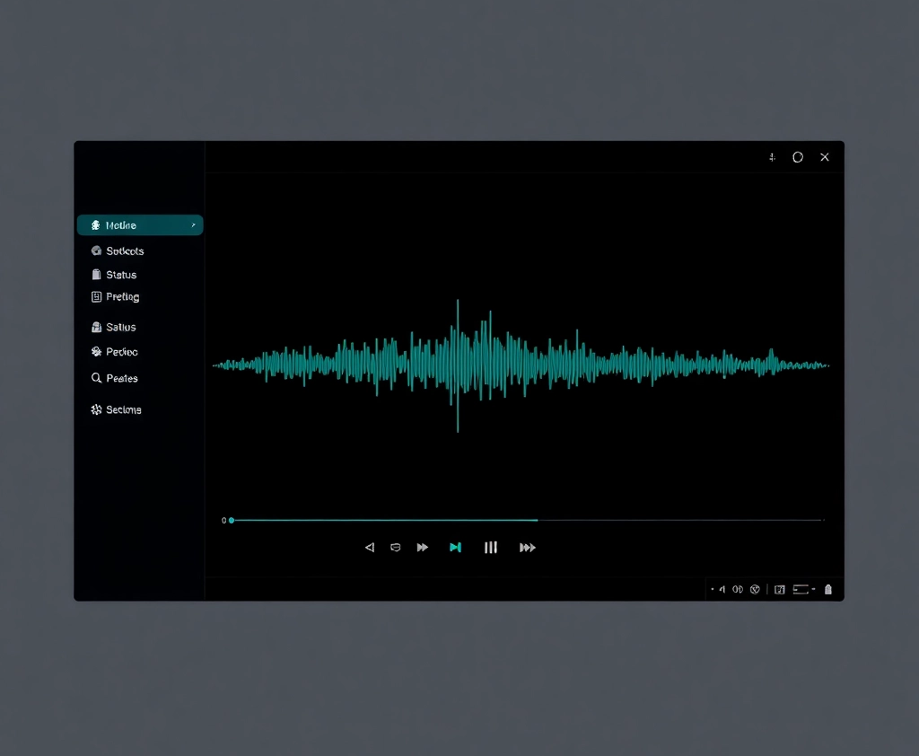
Solution intro
Meet ​J.A.R.V.I.S
AI-powered voice assistant for your desktop. Just say "Hey Jarvis" to open apps, browse the web, take screenshots, monitor your system, and more - hands-free, across multiple languages. ​ ​Built on a React + Vite frontend with a Python FastAPI backend.

Slide 7
PROJECT OBJECTIVES
J.A.R.V.I.S is designed to automate daily desktop tasks through voice - cutting manual effort and making AI-driven interaction practical and accessible.
AUTOMATION GOALS
INTELLIGENCE GOALS
Automate daily computer tasks through voice commands
Reduce manual effort for common operations
Provide real-time system information via voice queries
Demonstrate practical AI-based automation on the desktop

Slide 8
How it works
01
Wake word detection
User speaks a command. A wake word triggers J.A.R.V.I.S to start listening, activating the speech recognition engine.
02
Speech recognition
Voice input is processed and transcribed. The engine converts spoken words into text for the backend to interpret.
03
FastAPI routing and execution
The backend routes the command to the relevant module, executes the task, and returns a response via text-to-speech.
04
React dashboard feedback
The React + Vite frontend displays live status and feedback, keeping the user informed at every step of the interaction.

Slide 9
Core modules
Music control
Play, browse, and stop music entirely by voice command.
System monitor
Check battery, internet status, IP address, and launch apps on demand.
File manager
Search files, create folders, read text and PDFs, capture screenshots.
Communication
Send emails, open WhatsApp, and run web searches by voice.
Timers and alarms
Set timers, alarms, and trigger the calculator - all hands-free.
AI chat module
Conversational AI for open-ended queries and general assistance.

Slide 10
Technology stack
A modern, lightweight stack built for speed and extensibility.
Frontend
React + Vite
Fast UI rendering
Modular component architecture
Backend
Python FastAPI
High-performance API layer
Lightweight and async-ready
Voice recognition
Speech recognition libraries
Wake word detection
Command parsing
Output
Text-to-speech engine
Natural voice responses
Real-time audio playback

Slide 11

Strengths
Current limitations
What's working well
J.A.R.V.I.S already delivers meaningful productivity gains in controlled environments.
Hands-free interaction removes friction from common desktop tasks
Clean, minimal interface keeps the experience fast and intuitive
End-to-end automation handles repetitive workflows without manual input
Where improvement is needed
Several areas are still being refined before a broader rollout.
Voice recognition accuracy degrades in noisy environments
Some backend modules remain incomplete and are under active development
Edge case handling is limited - unexpected inputs can cause failures

Slide 12
Main modules used
Your program imports many Python libraries.
LIBRARY
USED FOR
speech_recognition
Voice commands
pyttsx3
Text-to-speech
openai
AI responses
os
File operations
subprocess
Running system commands
webbrowser
Opening websites
psutil
System info
pyautogui
Keyboard/mouse control
requests
Web APIs
json
Data storage
datetime
Date/time
threading
Parallel tasks
ctypes
Windows system calls

Slide 13

What's next for J.A.R.V.I.S
Offline voice recognition
No internet dependency
Reliable in any environment
Advanced natural language understanding
Interpret complex, multi-step commands
Smarter context handling
Cross-platform support
Windows, macOS, and Linux
Consistent experience across OS
Personalized assistant features
User profiles and preferences
Persistent memory across sessions
Phase 1
Phase 2
Phase 3
Phase 4

Slide 14
Conclusion
AI Voice Assistant
Hands-free computing, realized.
AI, automation, and voice - unified into one working desktop assistant.
J.A.R.V.I.S

